Slide 1
AN ELASTIC-PERFECTLY PLASTIC ANALYSIS OF THE BENDING OF THE LITHOSPHERE AT A TRENCH
DL. TURCOTTE, D.C. McADOO and J.G. CALDWELL
1977

Slide 2
Abstract
Modelled the flexure of the lithosphere with elastic thin plate some cases good agreement with observed topography is obtained but in other cases the slope of the fit lithosphere within the trench is greater that predicted by the elastic theory.
Elastic-perfectly plastic reology.
The elastic-perfectly plastic profiles are in excellent agreement with those profiles that deviate from elastic behavior.

Slide 3
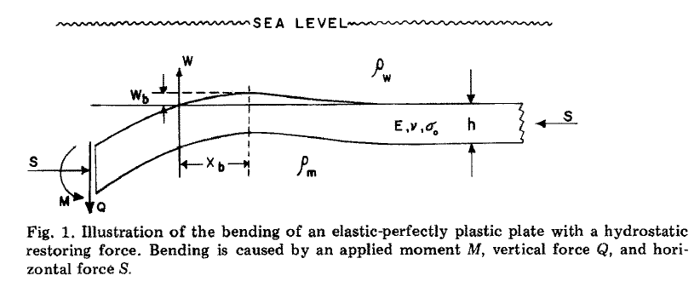
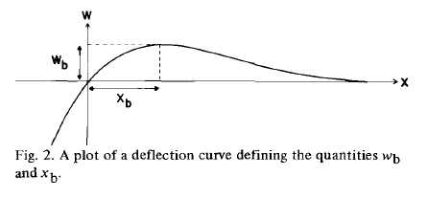
*Flexural rigidity
*Restoring force the deformation of the plate depends upon specified values of the
vertical force and horizontal force.
*Bending moment a at any point.
*Values of the horizontal force have only
a small effect on the deformation of the
lithosphere

Slide 4
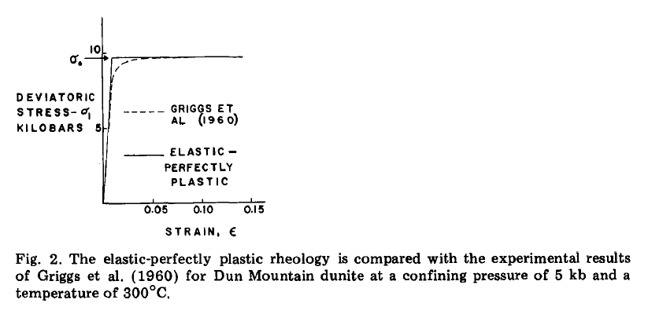
RHEOLOGY MODEL
Efective elastic thickness 20-30 km.
T below about 400˚C.
Maximun elastic bending 10 kb.

Slide 5




MODEL
Neglect the horizontal force, i.e., take S = 0

Slide 6
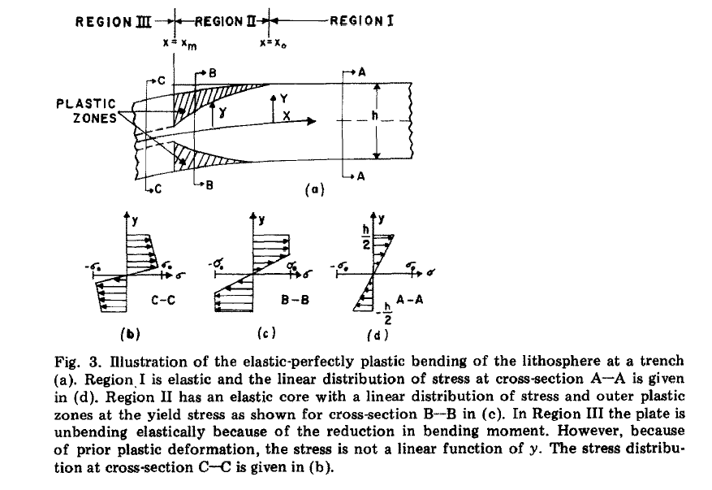

Slide 7




Deflection
Bending moment
Shear force
Maximum bending stress

Slide 8

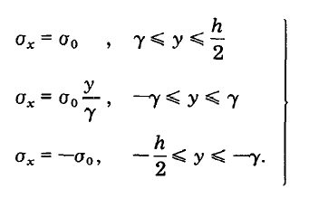
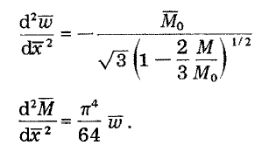


Maximum non-dimensional moment onset plastic
rheology
Plastic region
Deflection function
Bending moment partially plastic

Slide 9
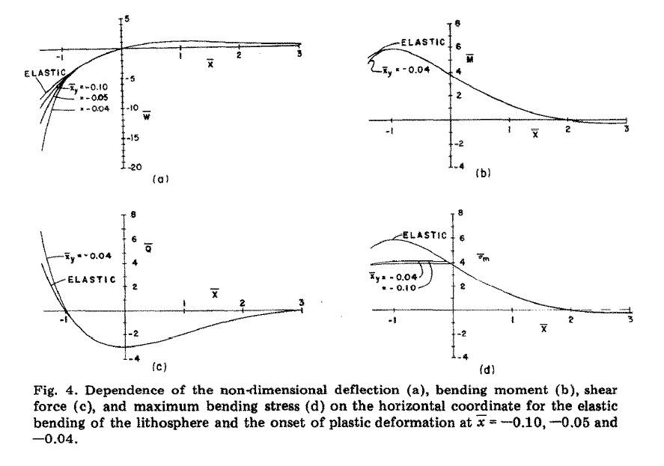

Slide 10
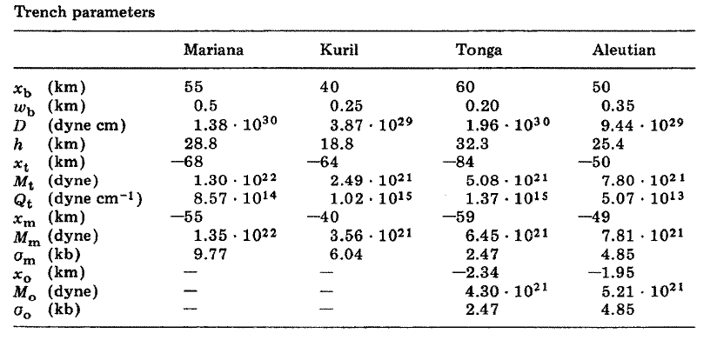
Comparision with observations

Slide 11
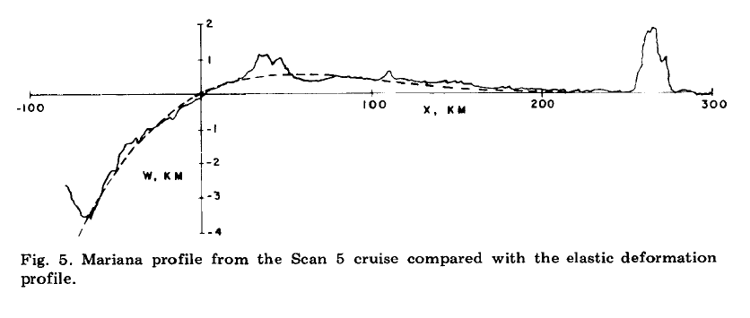
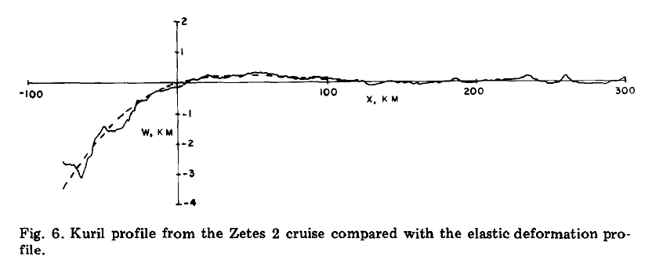

Slide 12
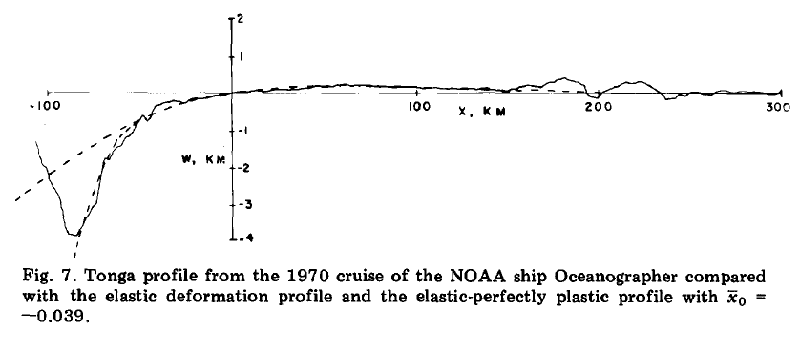
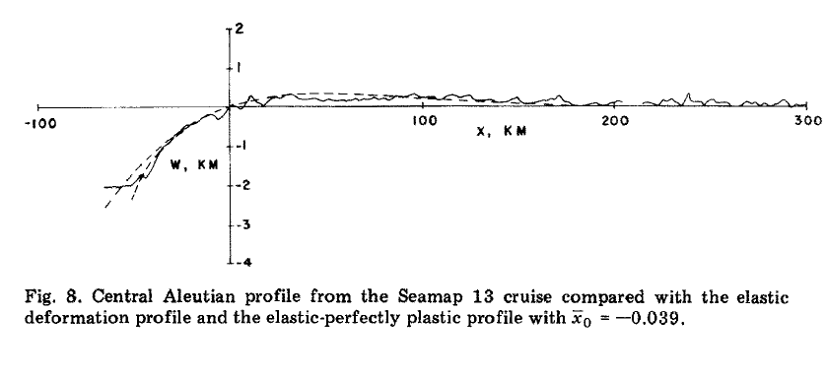

Slide 13
Conclusions
Trench profiles which do not fit the elastic theory appear to be in good agreement with the elastic-perfectly plastic analysis.
Derived lithospheric thicknesses vary from 19 to 32 km.
There does not appear to be a systematic dependence on lithospheric age.
The maximum bending stresses vary from 2.5 to 9.8 kb.
The maximum stress does not appear to correlate with lithospheric age or with lithospheric thickness.

